Slide 1
3 C
DATING APPLICATION
LOVE ONLINE
ON THE INTERNET

Slide 2

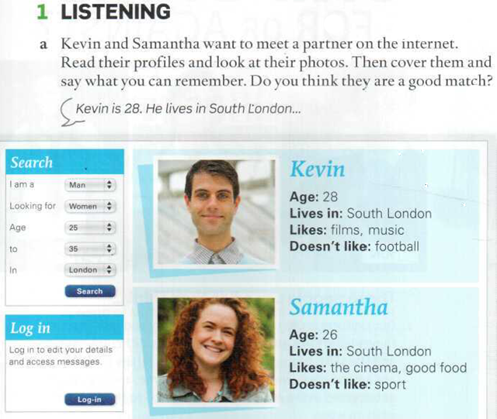
Read the profiles and speak about Kevin and Samantha.
How old is Kevin?
Where does he live?
Does he like films? Does he like music?
Does he like football?
How old is Samantha?
Where does she live?
What things does she like?
Does she like sport?
What do they have in common?
Are they a good match?

Slide 3
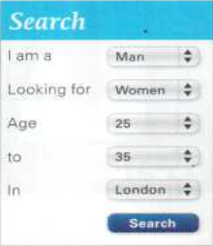

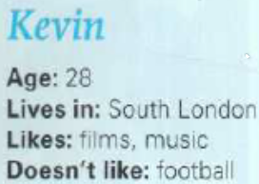
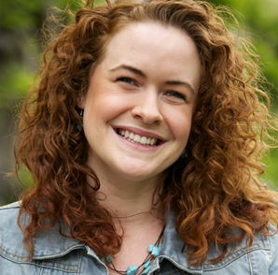
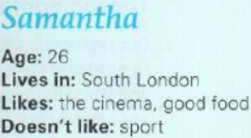
Read the profiles and speak about Kevin and Samantha.
How old is Kevin?
Where does he live?
Does he like films? Does he like music?
Does he like football?
How old is Samantha?
Where does she live?
What things does she like?
Does she like sport?
What do they have in common?
Are they a good match?

Slide 4
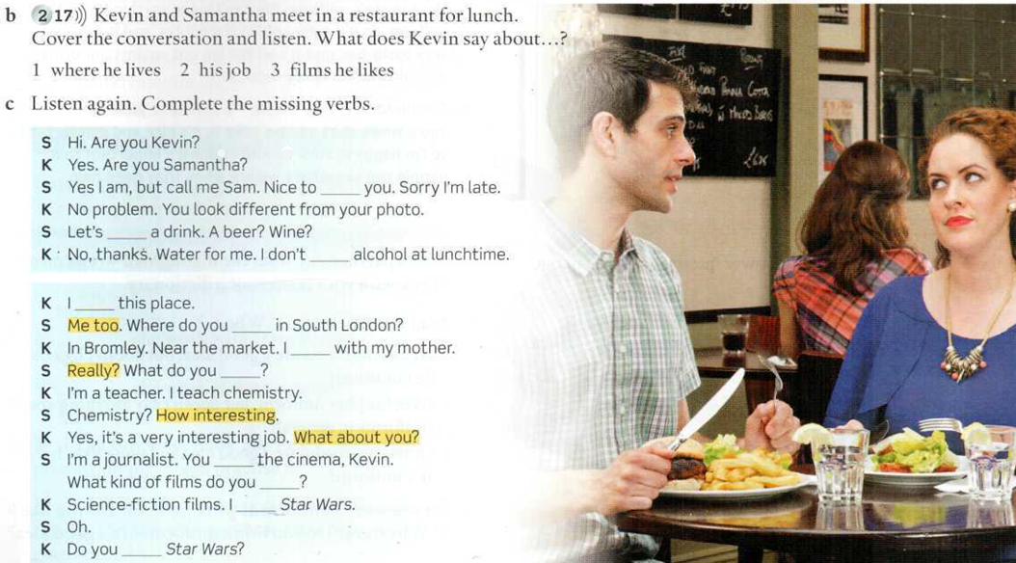
Now Kevin and Samantha are on their first date. Listen and complete.
meet
have
drink
like
live
live
do
like
like
love
like

Slide 5
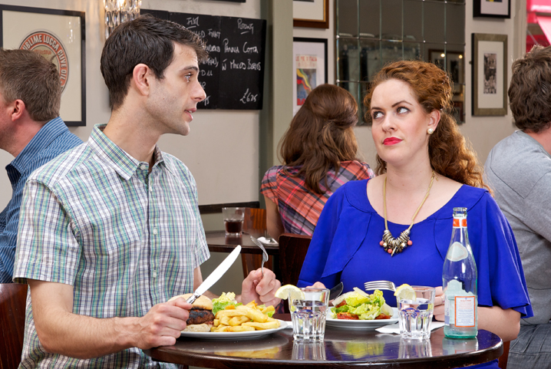
К = Kevin, S = Samantha
S Hi. Are you Kevin?
К Yes. Are you Samantha?
S Yes I am, but call me Sam. Nice to meet you. Sorry I’m late.
К No problem. You look different from your photo.
S Let’s have a drink? A beer? Wine?
К No, thanks. Water for me. I don’t drink alcohol at lunchtime.
К I like this place.
S Me too. Where do you live in South London?
К In Bromley. Near the market. I live with my mother.
S Really? What do you do?
К I’m a teacher. I teach chemistry.
S Chemistry? How interesting.
К Yes, it’s a very interesting job. What about you?
S I’m a journalist. You like the cinema, Kevin. What kind of films do you like?
К Science fiction films. I love Star Wars.
S Oh.
К Do you like Star Wars?

Slide 6
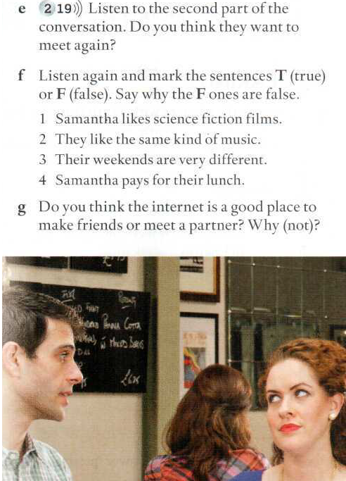
2-19
(script in Student’s Book on p.117)
К: Do you like Star Wars?
S: No, I don’t.
K: Why not? It’s a fantastic film.
S: I don’t like science fiction.
K: What kind of films do you like?
S: I love foreign films, French, Italian, Spanish.
K: Oh.
S: My salad’s very nice.
K: Good. My burger’s nice too.
S: What kind of music do you like?
K: Music? I love heavy metal. What about you?
S: Opera. ,
K: Opera - that’s really not my thing! Er... What do you do at the weekend?
S: I go to the cinema, I go to restaurants, I cook. I love good food. And you?
K: Well, I don’t cook! I meet friends and we play video games.
S: You meet friends and you play video games. Wow.
Do you want another drink? Oh, excuse me. Hi. Oh? Why? Now? OK. See you in a minute.
Sorry, Kevin. I need to go. Nice to meet you. Bye.
K: Oh. Bye.
Waiter: The bill, sir.
К: The bill! Hey, Samantha. Wait!
1 F (She likes foreign films.)
2 F (Kevin likes heavy metal and Samantha likes opera.)
3 T
4 F (Kevin pays for the lunch.)

Slide 7
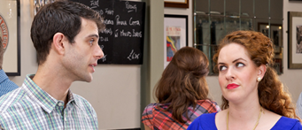
2-19 (script in Student’s Book on p.117)
К: Do you like Star Wars?
S: No, I don’t.
K: Why not? It’s a fantastic film.
S: I don’t like science fiction.
K: What kind of films do you like?
S: I love foreign films, French, Italian, Spanish.
K: Oh.
S: My salad’s very nice.
K: Good. My burger’s nice too.
S: What kind of music do you like?
K: Music? I love heavy metal. What about you?
S: Opera.
K: Opera - that’s really not my thing! Er... What do you do at the weekend?
S: I go to the cinema, I go to restaurants, I cook. I love good food. And you?
K: Well, I don’t cook! I meet friends and we play video games.
S: You meet friends and you play video games. Wow. Do you want another drink? Oh, excuse me. Hi. Oh? Why? Now? OK. See you in a minute. Sorry, Kevin. I need to go. Nice to meet you. Bye.
K: Oh. Bye.
Waiter: The bill, sir.
К: The bill! Hey, Samantha. Wait!
A get-out call
An escape call
A pre-arranged call to get out of the situation

Slide 8
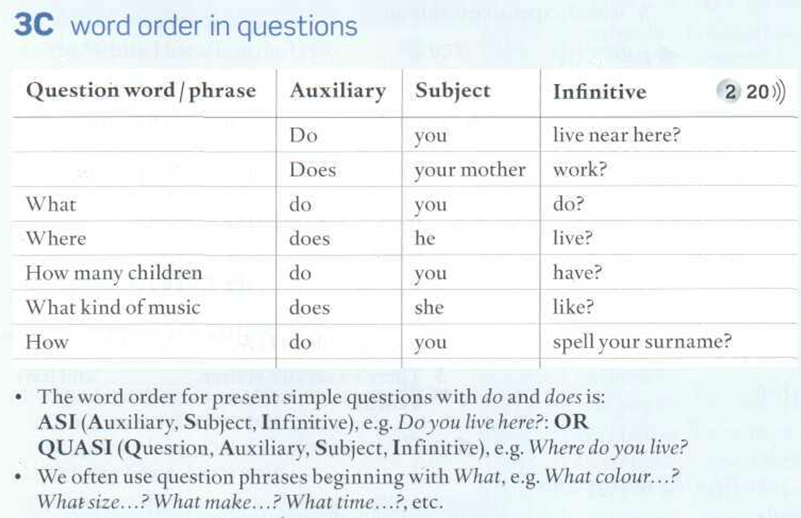
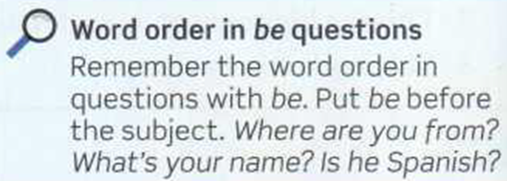
QUESTIONS. Please, read about Word Order in questions
Listen to the sentences and repeat them.

Slide 9
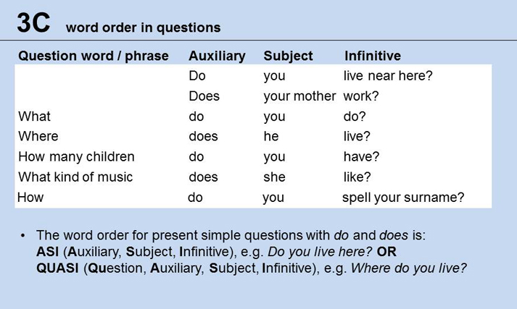

Slide 10
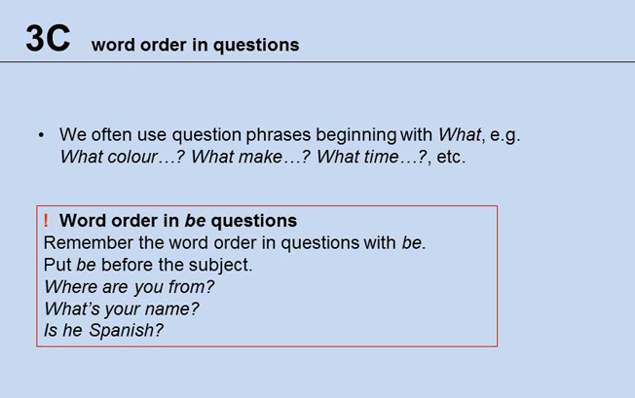

Slide 11
be
What | is | your name?
What day | is | today?
What | is | your favourite day of the week?
Who | is | your favourite singer/actor?

Slide 12
be
What | is | your favourite TV programme?
What | is | your favourite restaurant?
What | is | your favourite day of the week?

Slide 13

be
How | are | you ?
How old | are | you ?
How much | is | a coffee and a croissant?

Slide 14
Other verbs
What | do | you | do?
What food | do | you | like?
What kind of books | do | you | read?
What TV programmes | do | you | watch?
What phone | do | you | have?

Slide 15
Other verbs
What sports | do | you | play?
What magazines | do | you | read?
What languages | do | you | speak?
What car | do | you | have?

Slide 16
Other verbs
What kind of music | do | you | like?
What kind of music | do | you | listen to?
What kind of films | do | you | like?
What kind of food | do | you | like?

Slide 17
Other verbs
How | do | you | spell | your name ?
How many brothers and sisters | do | you | have | ?
How | do | you | do | ?

Slide 18
Other verbs
Where | do | you | live?
 | Do | you | like it?
Why | do | you | like it?
When | do | you | have English classes?
Which | do | you | prefer, Saturdays or Sundays?

Slide 19
Other verbs
How many brothers and sisters | do | you | have?

Slide 20
https://wordwall.net/es/resource/21810254/question-words

Slide 21
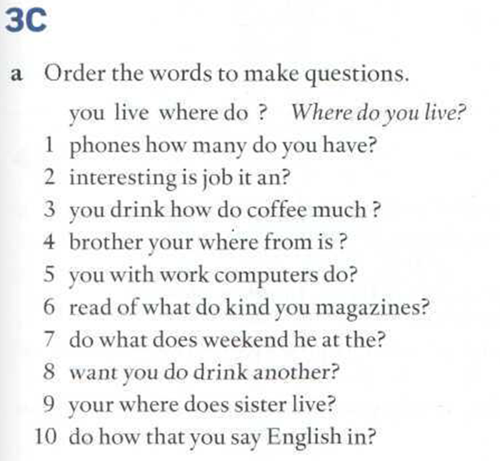
Page 129
Do the exercise
Listen to check
Repeat
1. How many phones do you have?
2. Is it an interesting job?
3. How much coffee do you drink?
4. Where is your brother from?
5. Do you work with computers?
6. What kind of magazines do you read?
7. What does he do at the weekend?
8. Do you want another drink?
9. Where does your sister live?
10. How do you say that in English

Slide 22
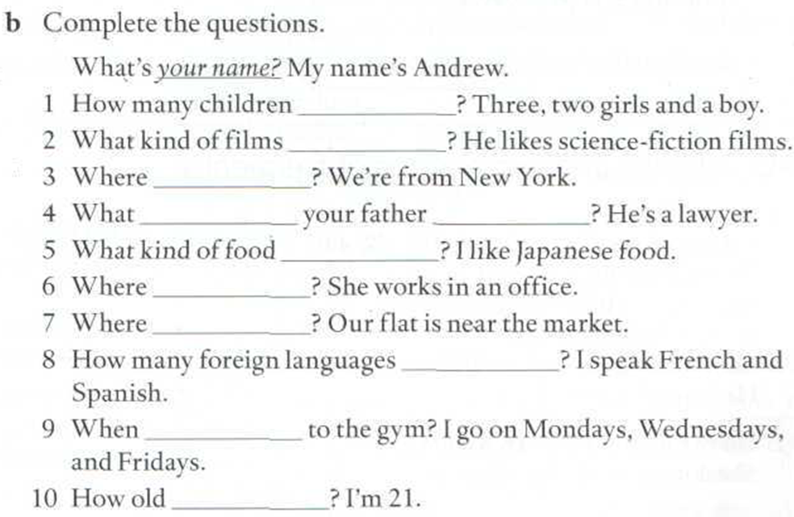
Page 129
do you have
does he like
are you from
does
do
do you like
does she work
do you live
is your flat?
do you speak
do you go
are you

Slide 23
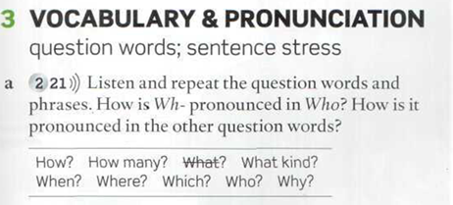
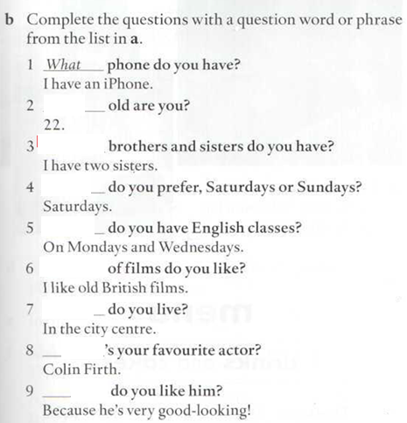







Slide 24
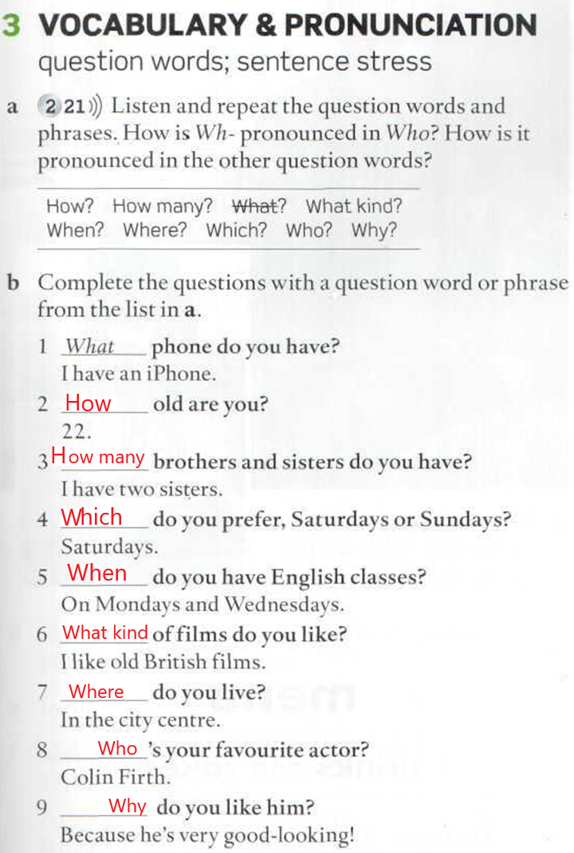
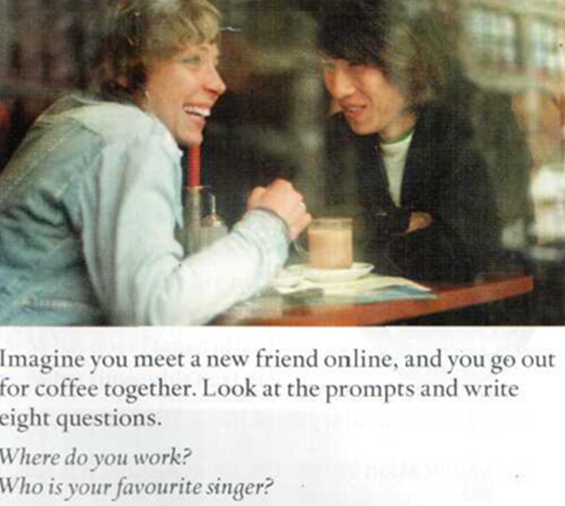
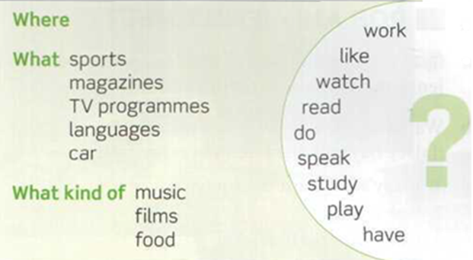

Slide 25
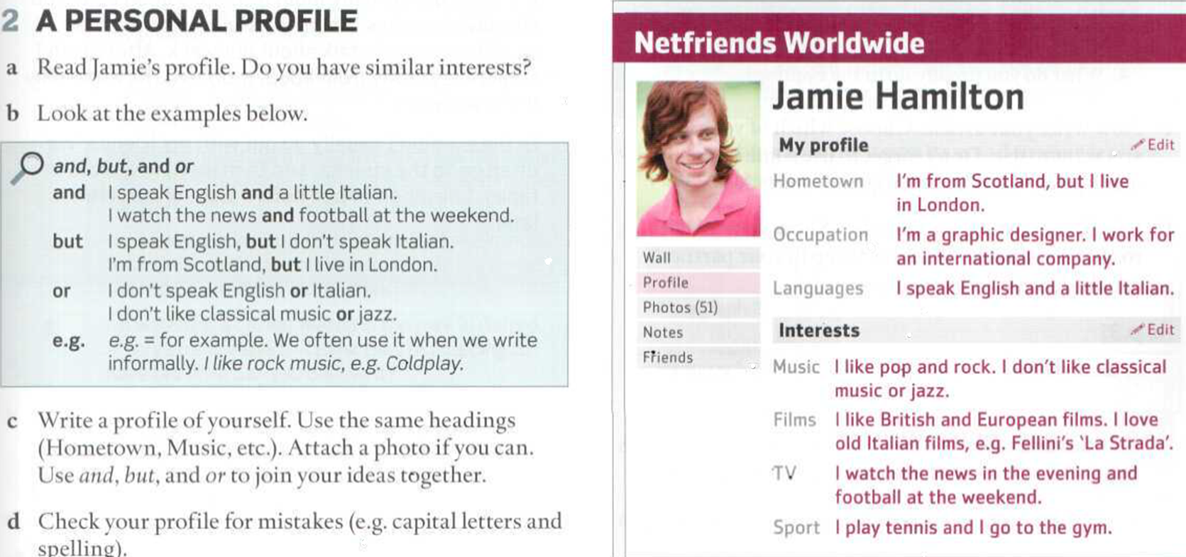
TP3 Written assignment (in class) : WRITE A PROFILE OF YOURSELF
1.Read the instructions
2. Pay attention to connectors and, but, or
3. Write your profile (similar to Jamie’s profile)
4. Attach a photo or paste a screenshot.

